Slide 1

VR Pacman
Group 2
Xiangyuan Xue Jiazi Bu Hanglei Zhang Zhulin Hu Qirui Li

Slide 2


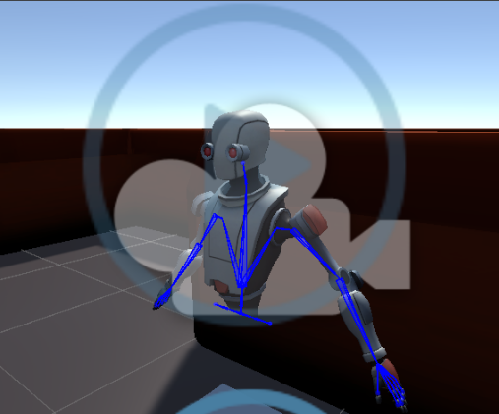
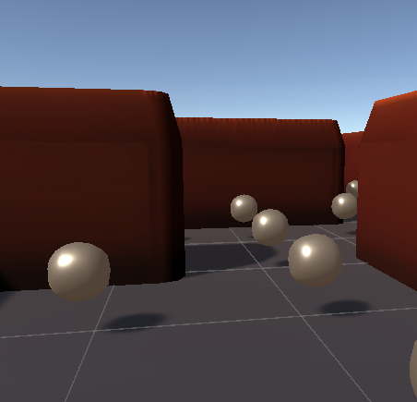
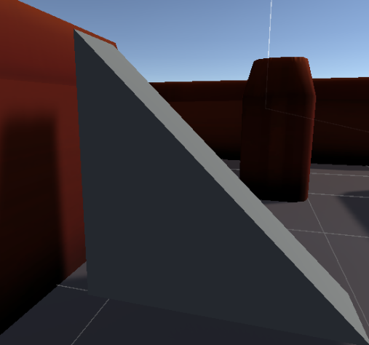
Exploration
Principles for VR Game
the First Person
Interaction

Slide 3

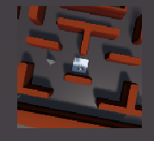
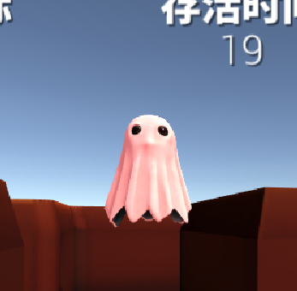

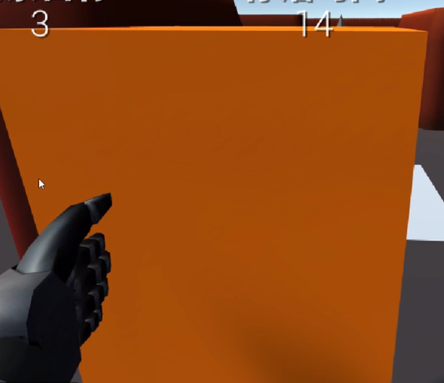
Features
Minimap Navigation Timer Interaction

Slide 4

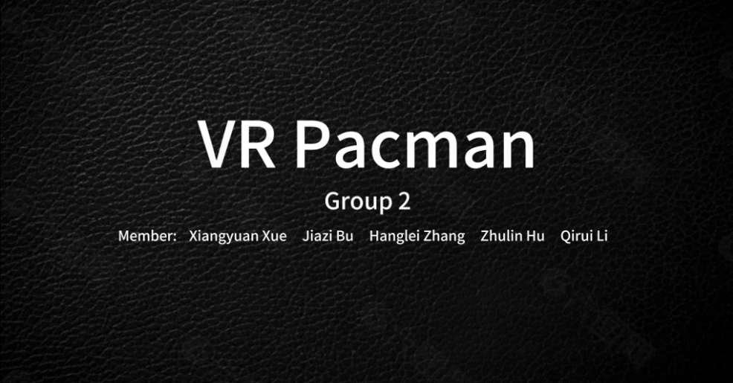
Demos
Please refer to https://jbox.sjtu.edu.cn/l/u1jjz4 for our latest demo.

Slide 5



Future Work
Richness of Content
Interaction Features
Maze Model
Recorder
……
Stability
Control Difficulty
Wall Area Obstacle
Pause and Other UI
……

Slide 6




